Slide 1
Oxbridge Puffer Generator
Jihwan Shin, Jin Rhee

Slide 2
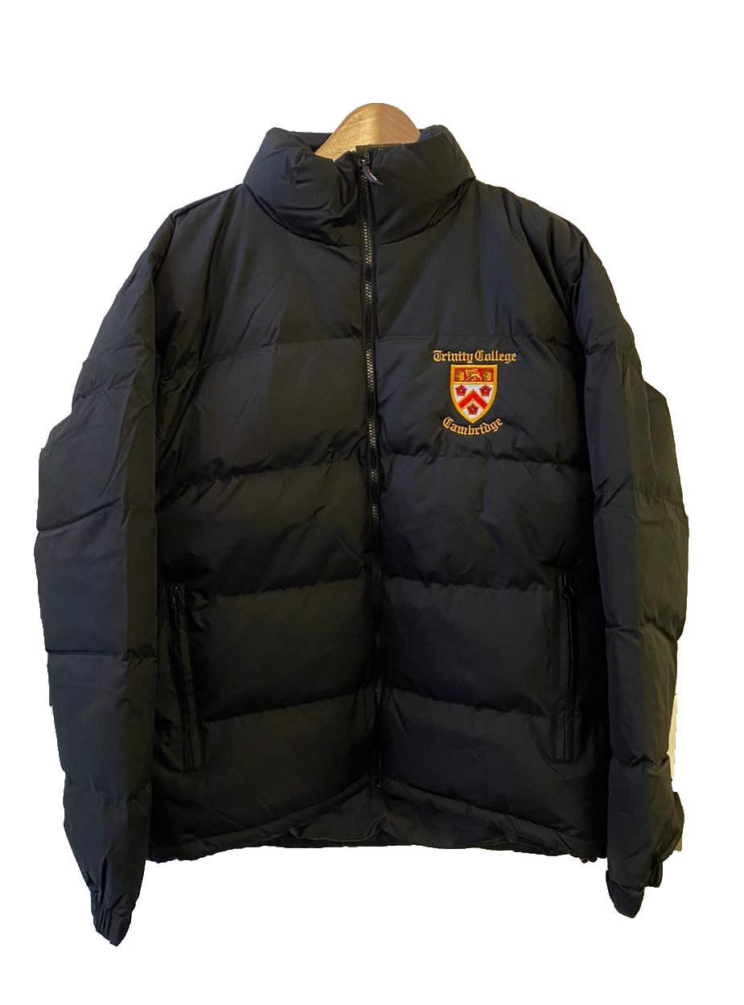
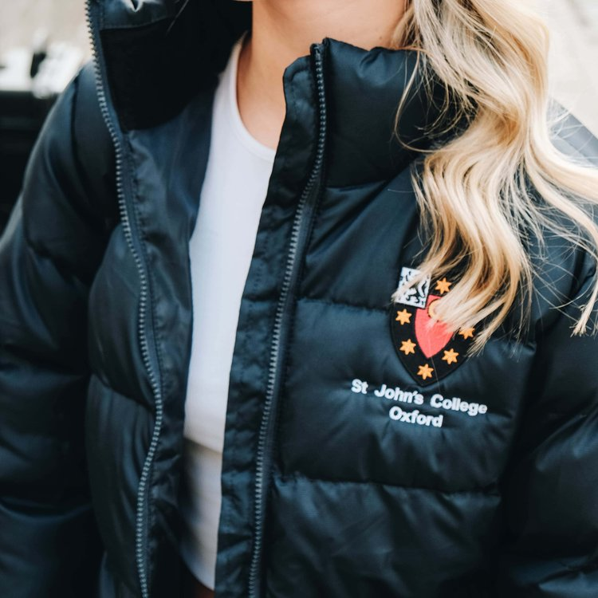
Oxbridge puffers
College puffer is an essential part of the Oxbridge experience. Many students wear puffers showing their college’s crests as a way of expression.
In this project, we created a machine learning software which is able to generate a college crest based on a given prompt, in order to make the most unique “college” puffer.

Slide 3
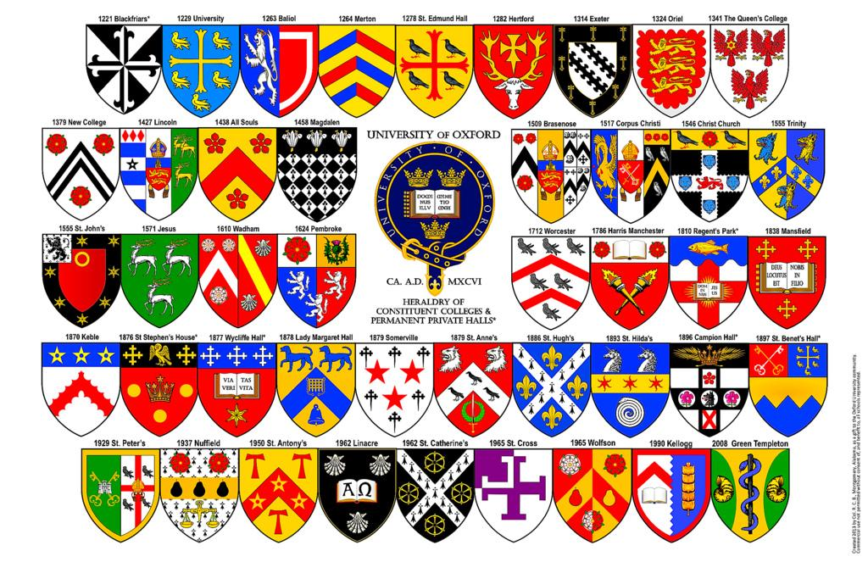
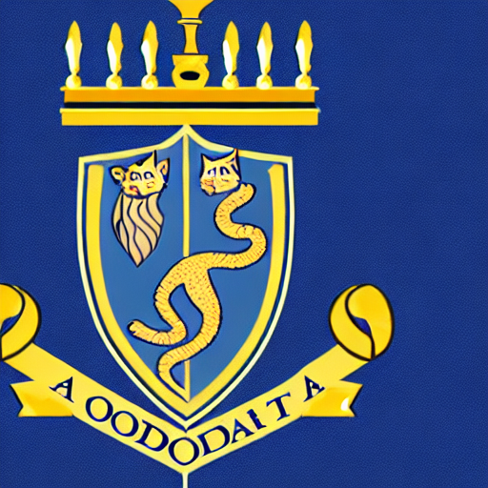

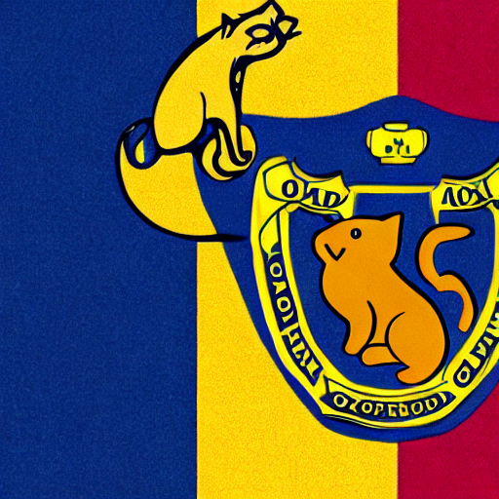


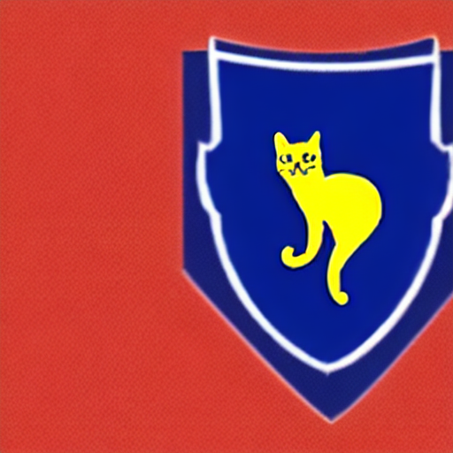

Training the model
The model was first trained based on 10 college crests, with the prompt “a photo of an oxford college crest that includes a cat” (shown below).
It was then expanded to a training set of 44 college crests (next two slides).
"a photo of an oxford college crest that includes a cat"

Slide 4
44
crests

Slide 5

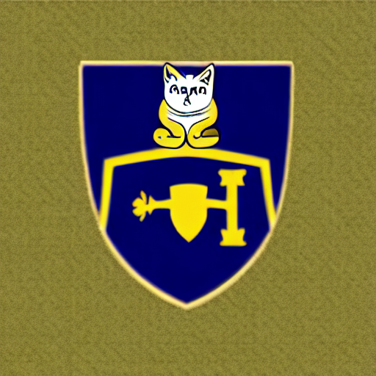
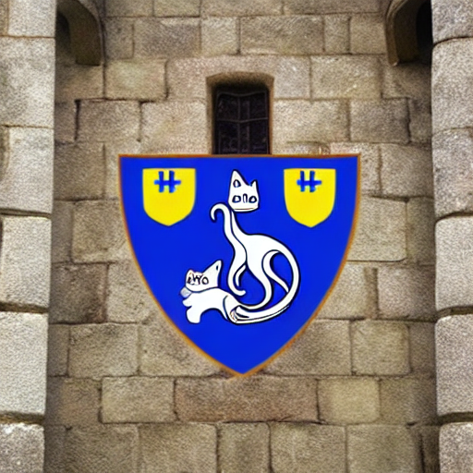
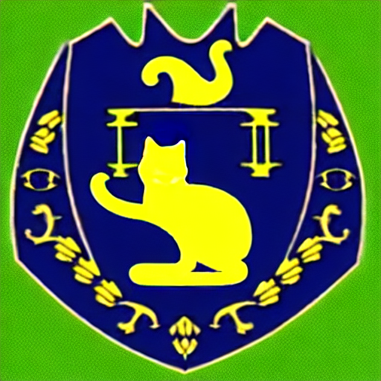

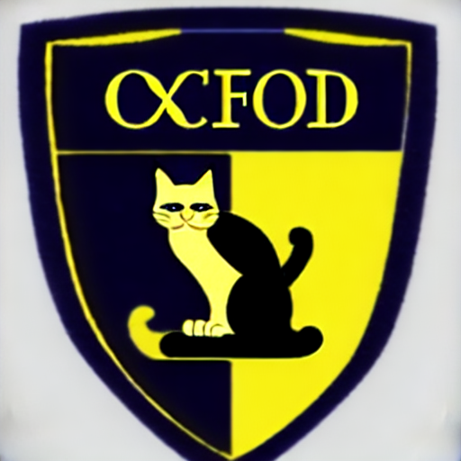
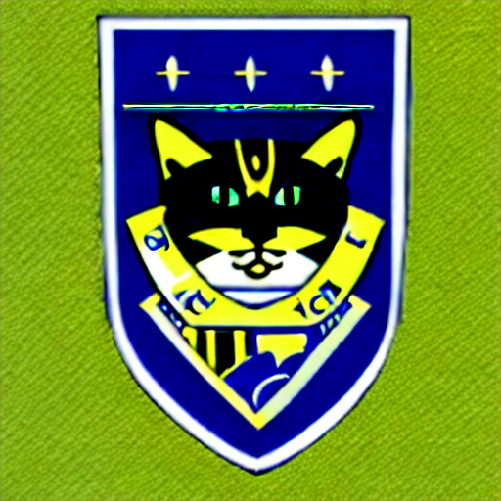
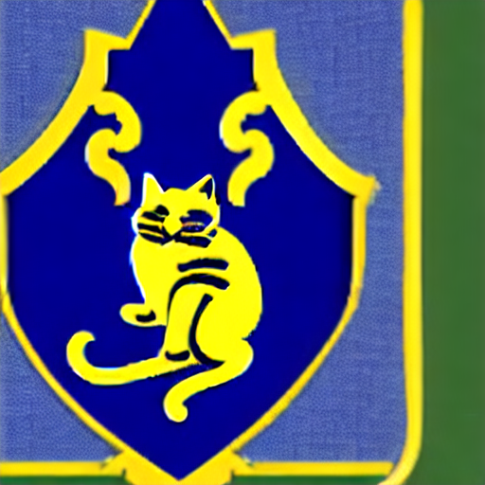

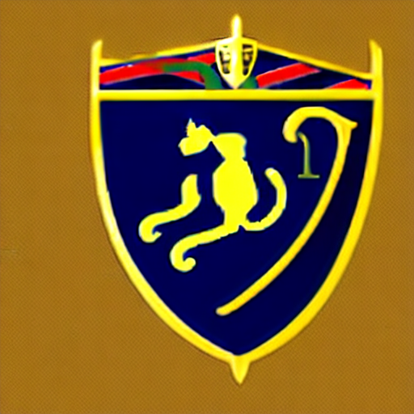

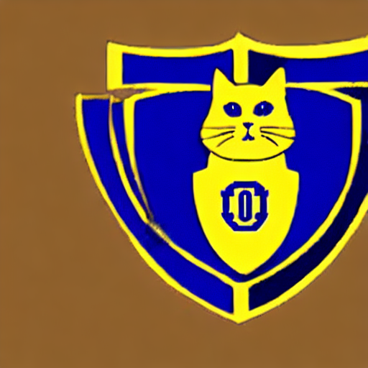
slightly
better!

Slide 6
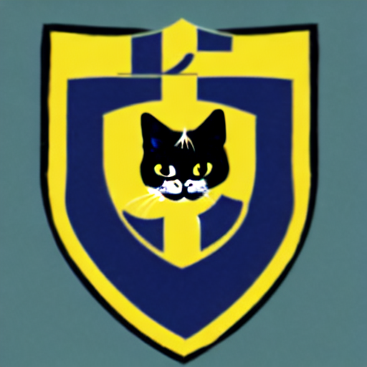


Optimizing the model
prompt = "a photo of an oxford college crest that includes a cat"
guidance_scale = 55
generated_image = pipe(prompt, num_inference_steps=55, guidance_scale=guidance_scale).images[0]
guidance_scale
→ changes how closely the generated image follows the prompt
The value has been iterated from 5 to 70 at increments of 5 to find the optimum range
Best results were shown at values around 50

Slide 7

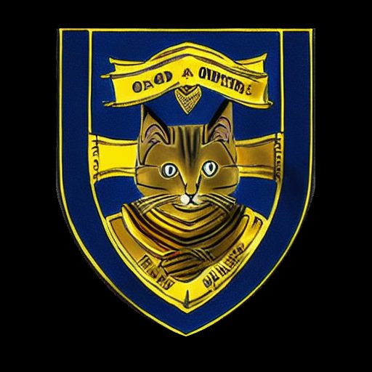
Restricting the shape of the crest
College crests must come in the shape of a shield, following the tradition.
This has been achieved by using a Controlnet by lllyasviel on Hugging Face, where a scribble of the outline of a crest shape was used, along with a masking process using OpenCV.

Slide 8
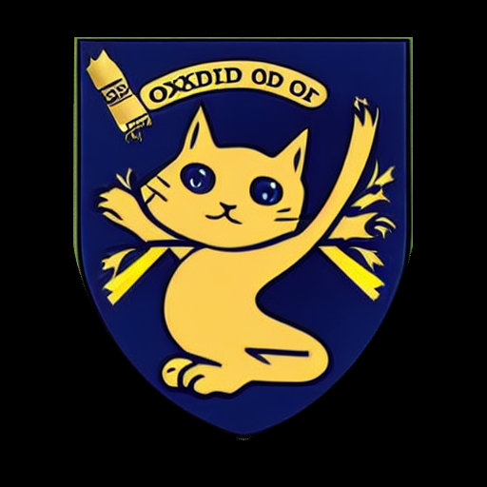



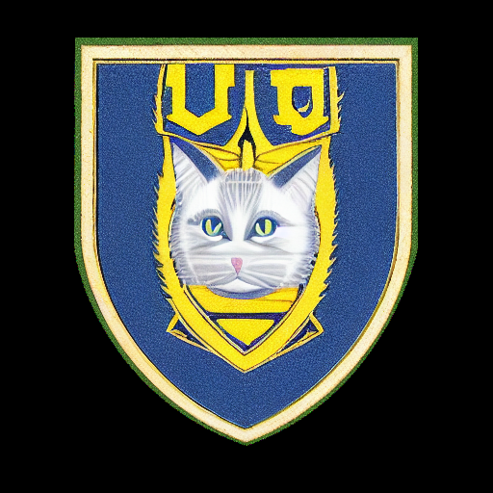


Some of the best final results…

Slide 9
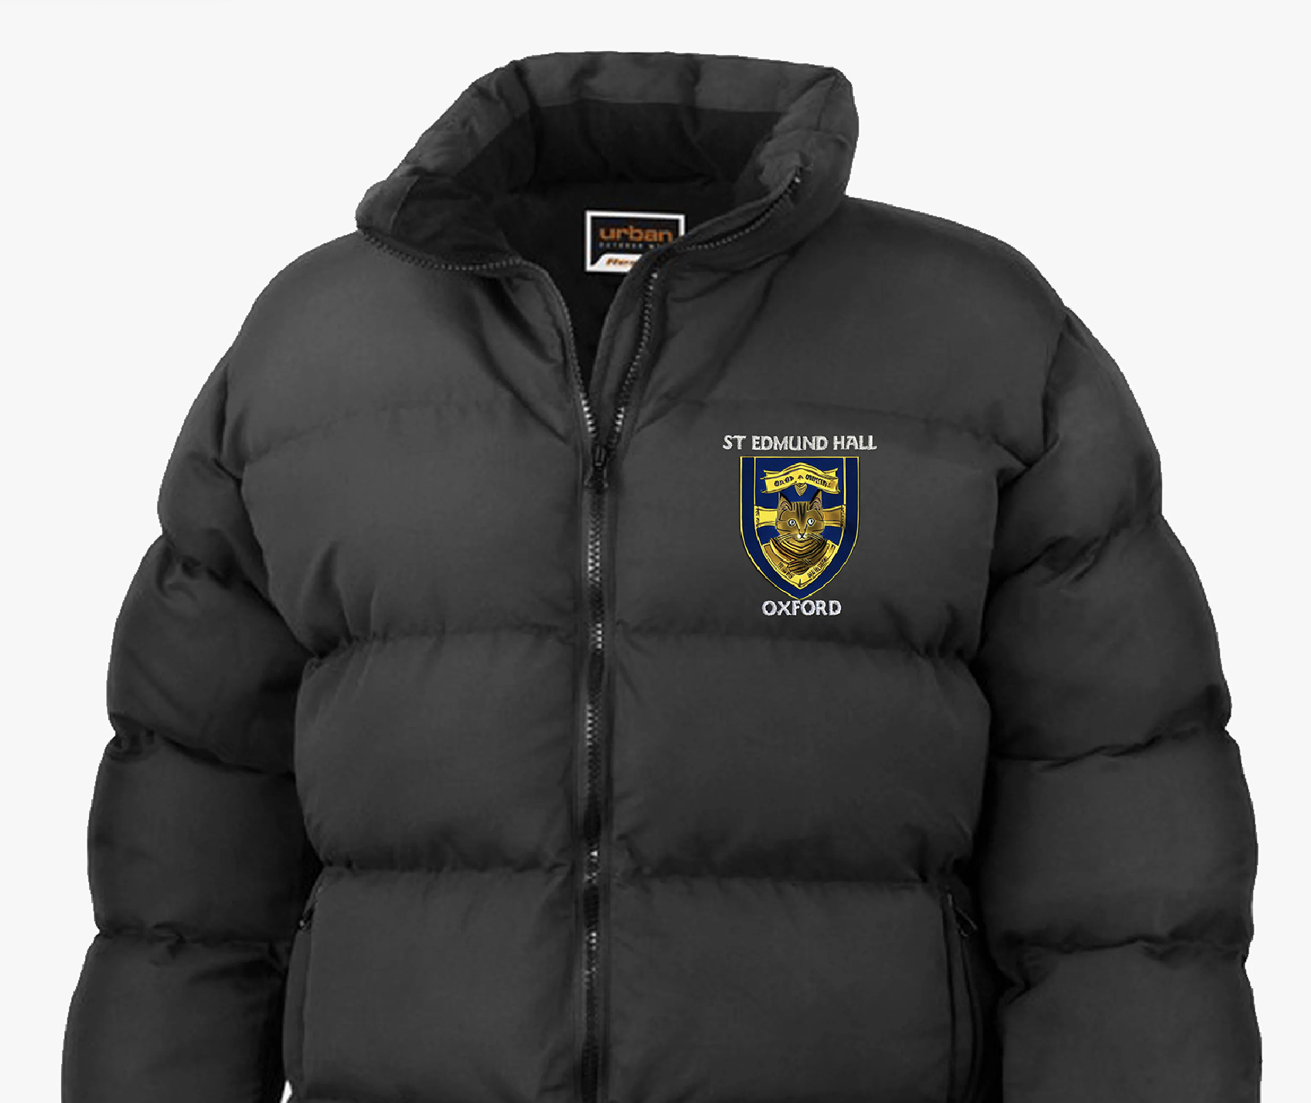
Visualisation of a generated college puffer…

Slide 10
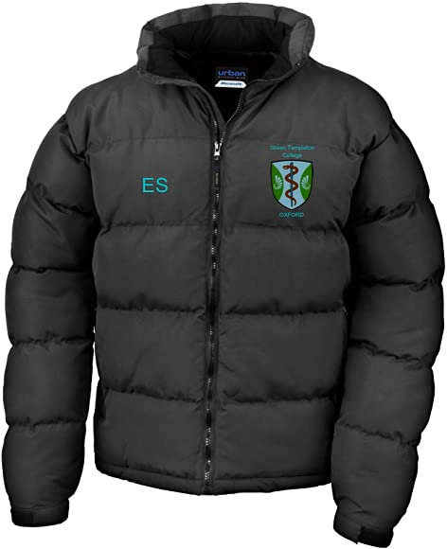
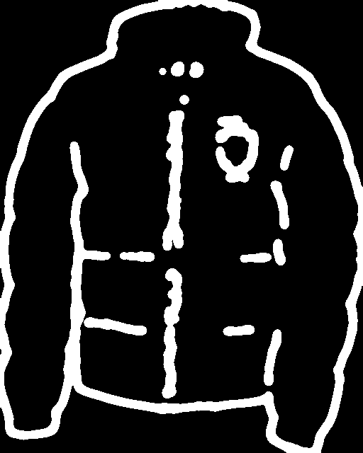

HED Detector (Scribble)
: takes an input image and outputs a 'scribble' version that vaguely matches the outlines of the photo.
How do we find location and orientation?
Figure (left to right): Original puffer image, HED-applied image, trimmed image showing college crest

Slide 11
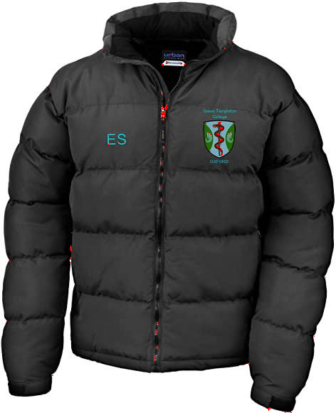

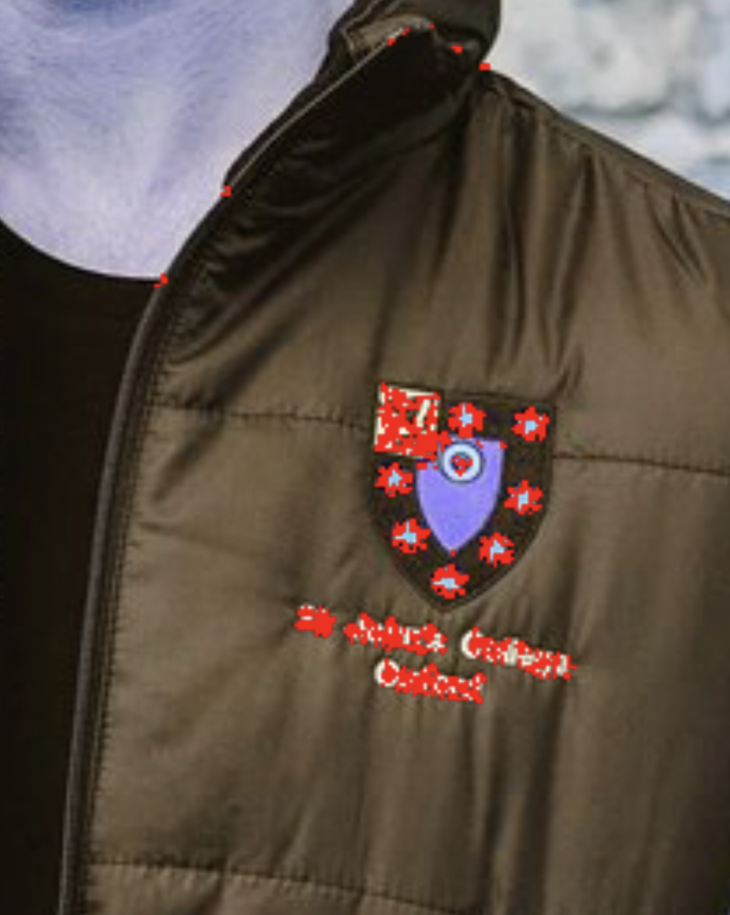

OpenCV Harris Corner Detection
: algorithmically locates and pin-points corners on given grayscale image
promising, but problematic
Figure (left to right): Corner detection output of original image, of HED output, and of another puffer image

Slide 12
Dilation and template matching (last-ditch)
: ‘dilate’ HED output and match for a given template
Template (grayscale)
Target
Expectations
While the last-ditch effort to automate the determination of the crest location and orientation failed; Harris Corner Detection seems the most promising starting point of future iterations.

Slide 13
Future extensions
Automatically locate the crest on a college puffer and edit the image using OpenCV to make it into a puffer with the newly generated crest
Provide a larger dataset (including Cambridge’s crests) to make it into a closer style to the university college crests
Make a web application where users can add their own prompt with configurations to flexibly generate their own college crest
Investigate further use of a mix of corner detection, dilation, and template matching

Slide 14

Real world applications
The same idea can be applied to creating a business logo, where the user can generate an infinite number of logos to choose from at zero cost of hiring a designer

